Slide 1
Basho Technologies
IDENTIFYING THE BIG IN BIG DATA

Slide 2
Three V’s

Slide 3
Volume
Velocity
Variety

Slide 4

Volume
Notes:
Physical items/objects to infinity
Total size
Necessary capacity expansion

Slide 5
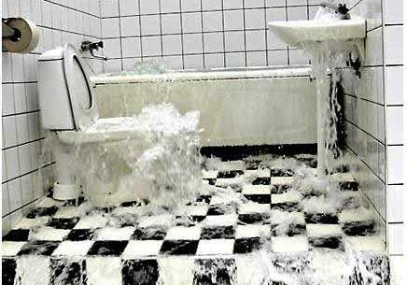
Velocity
Notes:
Single computer
through many computers
through firehose, and then secondary effects of creating internal firehoses once the data is inside your infrastructure.

Slide 6
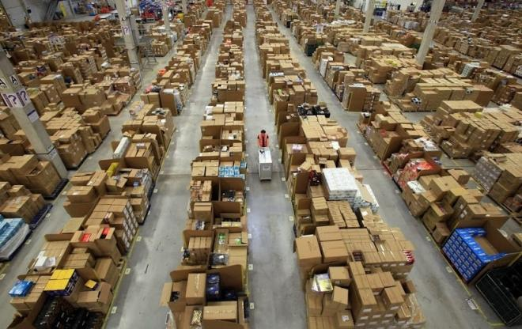
Variety
Notes:
Structured data, fixed formats (tables/rows/columns, XML, etc.)
Binary/raw data (possibly including metadata such as MP3)
?? Coming up with something for the concept of fuzzy data, ie. Siblings. Use cases where we don’t know the real answer ??

Slide 8

Volume
Velocity
Variety
Notes:
Wants to maintain live data of every patient’s DNA they sequence so they can keep it around for future analysis.
Needs to be able to store raw binary DNA sequence data.
Needs to be able to store results of DNA analysis also.

Slide 9

Volume
Velocity
Variety

Slide 10

Volume
Velocity
Variety

Slide 12



Notes:
Livingsocial
Daily national and regional discounts, deals, and coupons
Exelon
Nation’s second largest utility company
Yelp
- Location filtered restaurant and attraction information and reviews.

Slide 13
Volume
Velocity
Variety

Slide 14
Three V’s

